Slide 1
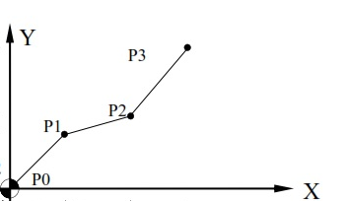
x₂
dx
x₁
dy
y₁
y₂

