Slide 1
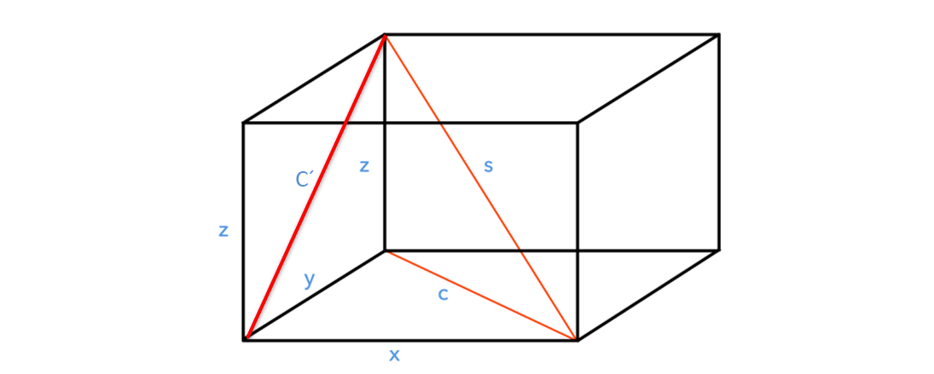
dz
dy
dx

